Slide 1
3D knapsack problem: Phase 3
Group #25

Slide 2
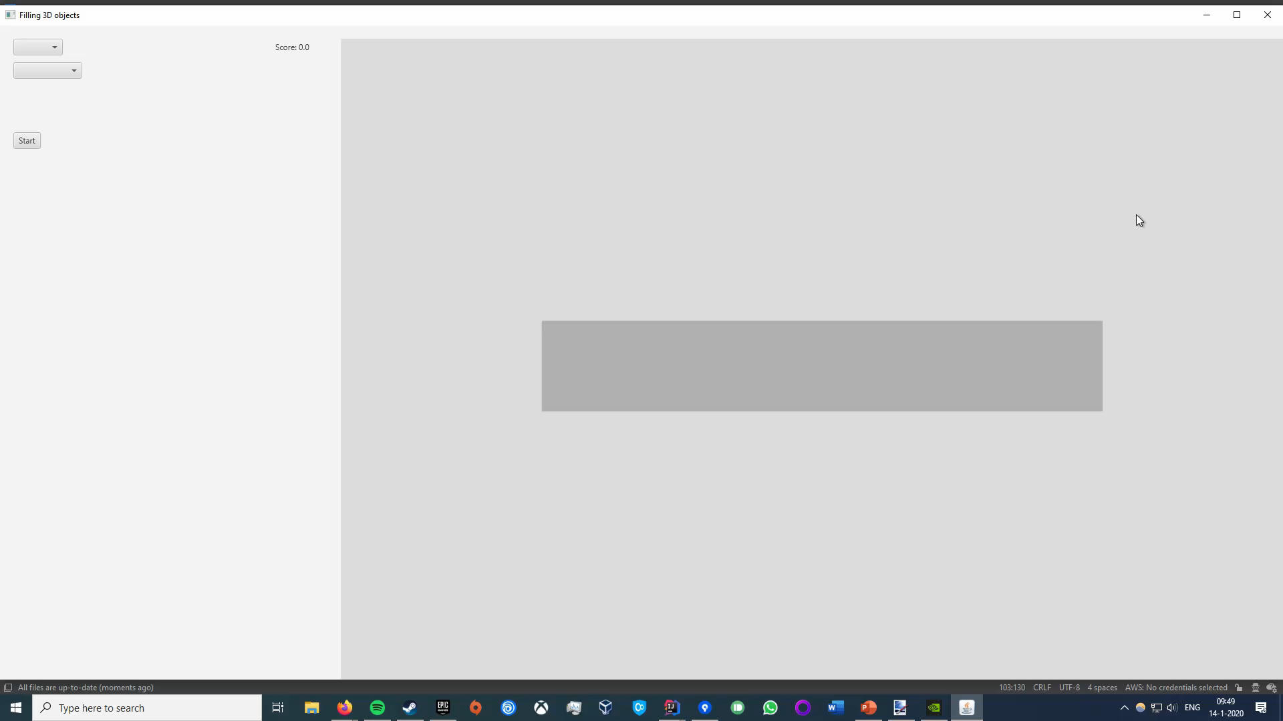
UI
2D input
3D output
Movement
Layer slider
Representation of objects

Slide 3
Different algorithms
 | Precision | Speed | Versatility | Difficulty to implement
Greedy | Low | Very fast | Medium | Easy
Genetic | Medium | Fast | High | Medium
X | Extreme | Very slow | Low | Medium
X modified | High | Decent | Medium | Hard
Greedy algorithm
Genetic algorithm
Algorithm X
Notes:
When either the pentominoes or parcels are chosen, the algorithm changes so it works for one of them.
The scoring method we use is the type of the pentominoe/parcel multiplied by the value of the chosen type.
After we get the score, the score is sent to the algorithm, and this part is the communication between the score and the algorithm.

Slide 4
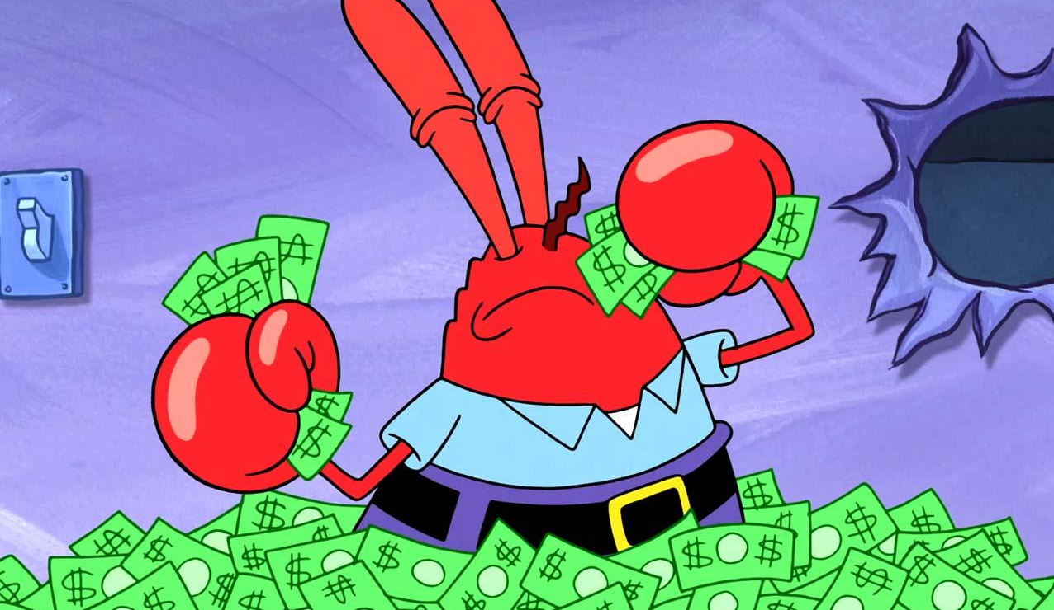
Greedy algorithm
Find the most value dense type
Use it as much as possible
Notes:
When either the pentominoes or parcels are chosen, the algorithm changes so it works for one of them.
The scoring method we use is the type of the pentominoe/parcel multiplied by the value of the chosen type.
After we get the score, the score is sent to the algorithm, and this part is the communication between the score and the algorithm.

Slide 5
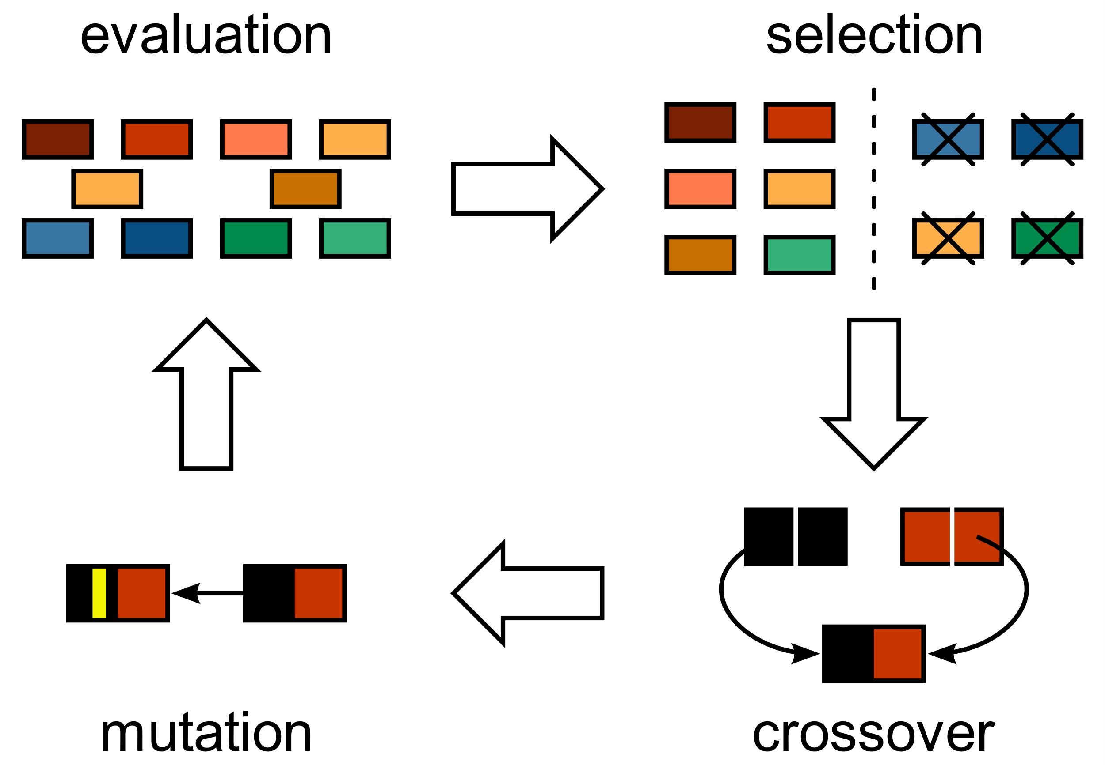
Genetic algorithm
This Photo by Unknown Author is licensed under CC BY-SA
Originated from the pent-Tetris algorithm
Keeps improving
Notes:
When either the pentominoes or parcels are chosen, the algorithm changes so it works for one of them.
The scoring method we use is the type of the pentominoe/parcel multiplied by the value of the chosen type.
After we get the score, the score is sent to the algorithm, and this part is the communication between the score and the algorithm.

Slide 6
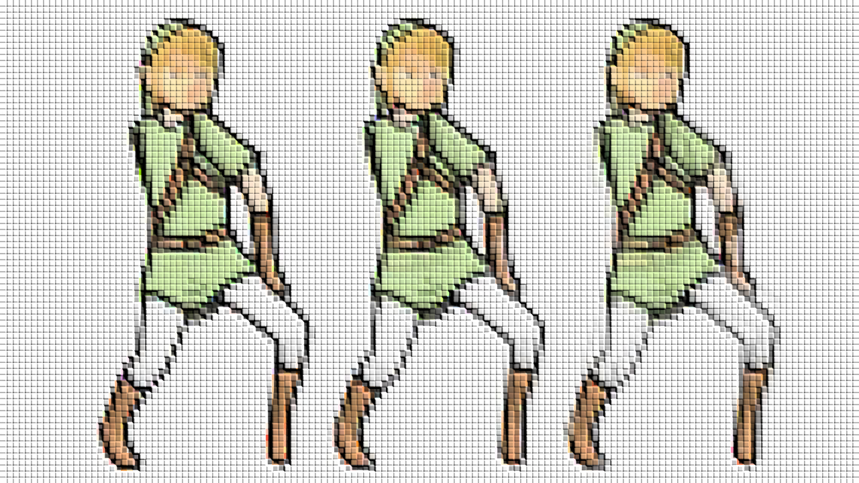
Dancing links
Algorithm X with dancing links
The use of dancing links is useful because it reuses the objects which prevents insertion of objects.
Modified to work with partial solutions
The algorithm attempts to fill the container and removes overlapping parts.
The solution with the highest score is picked.
Notes:
When either the pentominoes or parcels are chosen, the algorithm changes so it works for one of them.
The scoring method we use is the type of the pentominoe/parcel multiplied by the value of the chosen type.
After we get the score, the score is sent to the algorithm, and this part is the communication between the score and the algorithm.

Slide 7
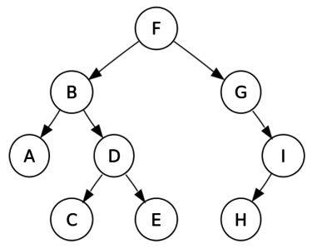
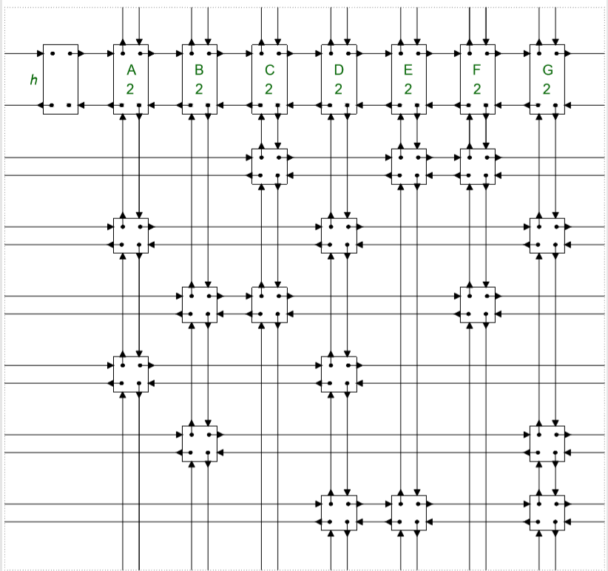
Dancing links

Slide 8
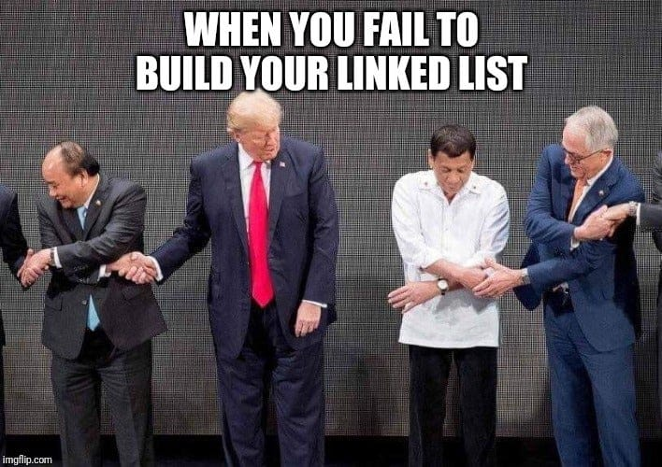
Dancing links challenges
Making array with all possible 3D rotations can be difficult.
The creation of the dancing links itself can be difficult as it involves a lot of steps.
Dancing links is not meant for solving partial cover problems(the reason behind adding adjustments to fit the problems ).
The default version is pretty slow since it considers all possible options and the amount of options is huge.
Notes:
When either the pentominoes or parcels are chosen, the algorithm changes so it works for one of them.
The scoring method we use is the type of the pentominoe/parcel multiplied by the value of the chosen type.
After we get the score, the score is sent to the algorithm, and this part is the communication between the score and the algorithm.

Slide 9

Any questions?

